Slide 1
Assignment
27-03-25
Presented by S.Vinish

Slide 2
Subnet & Subnet Mask

Slide 3
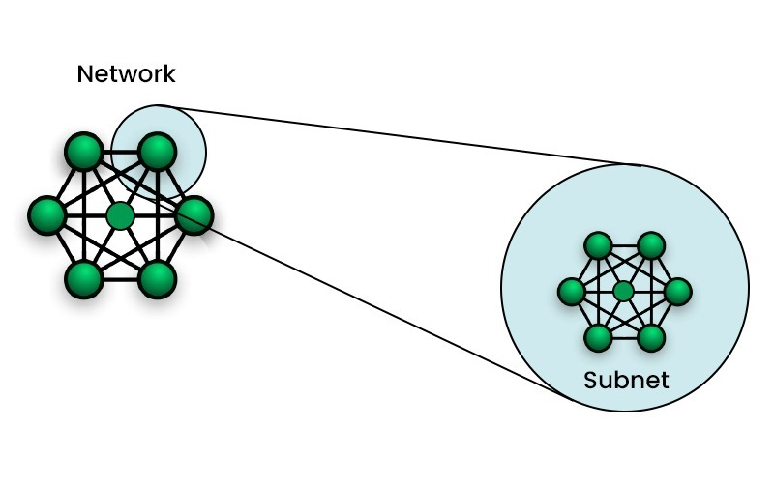
What is Subnet?
A Subnet is like a smaller group within a large network.
It is a way to split a large network into smaller networks so that devices present in one network can transmit data more easily.
The process of dividing a large network into smaller networks is known as ”Subnetting”.
Each subnet is a smaller group of devices that can communicate directly with each other.

Slide 4
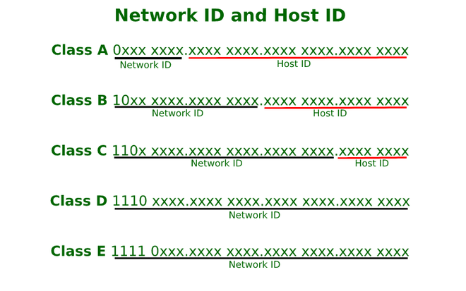
What is Subnet Mask?
A Subnet Mask is a 32-bit number used in IP addressing to separate the network portion of an IP Address from the host portion.
IPv4 consists of
Class A: 8-bit network ID, 24-bit host ID.
Class B: 16-bit network ID, 16-bit host ID
Class C: 24-bit network ID, 8-bit host ID.

Slide 5
Subnet Mask in CIDR Notation (/ Notation)
Instead of writing 255.255.255.0, we use CIDR (Classless Inter-Domain Routing) notation:
Subnet Mask CIDR Notation
255.0.0.0 /8
255.255.0.0 /16
255.255.255.0 /24
255.255.255.128 /25

Slide 6
Public IP Addresses & its Examples:
Public IPs typically fall outside the private IP ranges (10.x.x.x, 172.16.x.x - 172.31.x.x, 192.168.x.x). Here are some examples:
Google DNS: 8.8.8.8
Cloudflare DNS: 1.1.1.1
Facebook Server: 157.240.22.35
YouTube Server: 142.250.190.14

Slide 7
Benefits of Subnet Mask:
✅ Defines Network & Host Portions ✅ Improves Network Efficiency ✅ Reduces Traffic Congestion ✅ Enhances Security by Isolating Subnets ✅ Simplifies Routing in Large Networks

